Slide 1
Two Level formations
Combine strict geometric formations with flexibility of an emergent approach
First Level
Use a geometric formation as before
Pick Leader NPC to move the formation
Leader steers the formation
Second Level
Other NPCs use slots are targets
Use their own collision avoidance etc. (flexible behaviour)
Use arrive behaviour
Leader should not move at maximum velocity

Slide 2
Removing the leader
Issue with leader mimicking
Use invisible leader
All NPCs follow this
All NPCs are the same
no separate leader
Invisible leader slot does not need to worry about
small obstacles, other NPC collisions, etc.
No need to worry about replacing leader if she dies
Simplified code implementation
We refer to the “leader” as the anchor point

Slide 3
Moderating Movement
The consequence of an invisible leader?
Obstacles?
Formation speed?
What’s going on behind?
Slow down leader
can be too slow!
Better to base speed on distance between individual NPCs and their slots (keep the anchor point on a leash)
Get average distance from NPCs to slots
Update anchor point based on this
Notes:
A leader is not constrained by obstacles, but the other NPCs are!

Slide 4
Moving to a standstill
If we use arrive behavior then formation will slow down and stop
because they are always near slot and slow as they get nearer => anchor point will slow
Use offset to ensure target is always a minimum distance ahead of group
Move a fixed distance ahead based on group velocity
P_{anchor} = P_{c} + K_{offset}*V_{c}
P_{c} = Position of centre of mass
V_{c} = Velocity at centre of mass

Slide 5
Update pseudocode
def updateSlots():
anchor = getAnchorPoint()
orientation = anchor.orientation.asVector()
for i in 0..slotAssignments.length():
relativeLoc = pattern.getSlotLocation(slotAssignments[i].slotNumber)
location = new Location()
location.position = relativeLoc.position * orientation + anchor.position
location.orientation = anchor.orientation + relativeLoc.orientation
slotAssignments[i].character.setTarget(location)

Slide 6

Drift
Anchor point of formation must be at the centre of mass of occupied slots (average position)
Otherwise when formation is supposed to be stationary it will drift
To update this:
P_{c} = 1/n * (P_{Si} if occupied else 0)
P’_{Si} = P_{si} - P_{c}
P_{si} = Position of slot i

Slide 7
Drift
Drift can also affect orientation
Causing group rotation (spin on the spot)
Similar fix:
W_{c} = 1/n * (W_{Si} if occupied else 0)
W’_{Si} = W_{si -} W_{c}
W_{si} = Orientation at slot i
Do infrequently
Costly
Needs to be redone only if slots change. e.g.?
Notes:
e.g. might be that an NPC is destroyed/leaves the formation

Slide 8
Implementation
Pseudocode for a formation manager…
We can make use of a formationPattern class:
int numberOfSlots //number of slots in pattern
getDriftOffset(slotArray)
getSlotLocation(slotNumber)
supportsSlots(count)

Slide 9
Sample Formation Manager
struct slotAssignment
character
slotNumber
slotArray: array of slotAssignment
driftOffset // struct containing position and
// orientation of filled slots
pattern :formationPattern
…

Slide 10
updateSlotAssignments()
int i=0
for s in slotArray:
s.slotNumber = i
i++
driftOffset = pattern.getDriftOffest(slotArray)

Slide 11
addCharacter(npc)
occupiedSlots = slotArray.length
if pattern.supportsSlots(occupiedSlots+1):
newAssignment = new slotAssignment
newAssignment.character = npc
slotArray.append(newAssignment)
updateSlotAssignments()
return true
else
return false

Slide 12
removeChar(npc)
slot = find(slotArray, npc)
if slot in 0..slotArray.length
slotArray.removeAt(slot)
updateSlotAssignments()

Slide 13
updateSlots()
anchor = getAnchorPoint()
orientationMatrix = anchor.orientation.asMatrix
foreach s in slotArray:
relLoc = pattern.getSlotLocation(s.slotNumber)
location.position = relLoc.position * orientationMatrix + anchor.position
location.orientation = anchor.orientation + relLoc.orientation
location.position = location.position – driftOffset.position //Add in drift
location.orientation = location.orientation - driftOffset.orientation
s.character.setTarget(location)

Slide 14
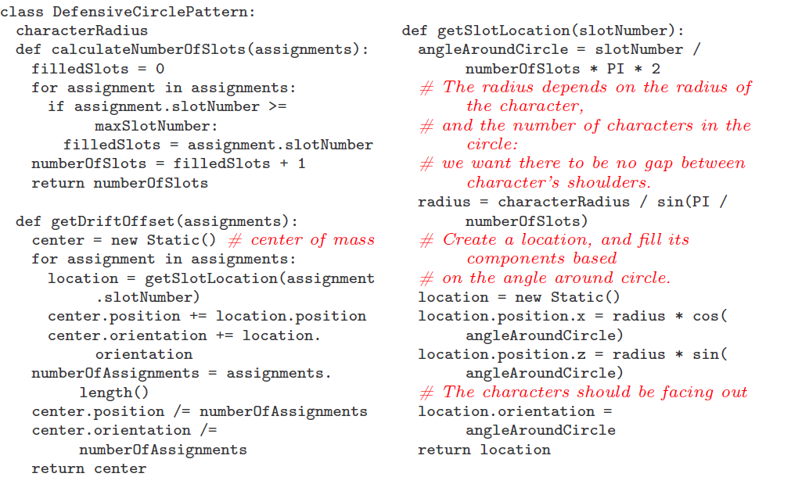
Example

